Slide 1

IDEA CREATION-2 on
QUIZ BUZZ
Batch Number : CS Alpha-04
By
B.Bhavana (2311cs040020)
K. Pardhu (2311cs040089)
A.Vyshnavi (2311cs040013)
E.Vivek (2311cs040050)
G.Sadhvik (2311cs040062)
Under the Esteemed Guidance of
Mrs.M.Sucharitha ( Assistant Professor )

Slide 2
OVERVIEW of the Presentation :-
Abstract
Objectives
Literature Survey
Introduction
Existing System
Propose System
Data Flow Diagram
Methodology
System Requirements
Conclusion

Slide 3
ABSTRACT:
Quiz Buzz is generates new questions and the levels of critical thinking problems is functioned although u can set the difficulty and you can choose interested yet desired topic so that one can focus on the particular subject. We additionally have an option of choosing all subject questions in a single quiz and grades will be stored so that improvement can be regulated on regular basis.
The Quiz Buzz also incorporates diverse question formats, including multiple-choice, true/false, and open-ended questions, fostering a comprehensive understanding of the subject matter. Additionally, it offers instant feedback and detailed explanations, promoting active learning and addressing misconceptions.

Slide 4
Objective :
The app will offer various types of quizzes, including jee mains, advance, emcet, sports, and general knowledge. Users can choose from a range of topics that interest them. The quiz buzz primary goal is to engage users by challenging their knowledge and curiosity. Well-structured questions and captivating content will keep users coming back for more. The app intends to strike a balance between education and entertainment. Users can learn new facts while enjoying the quiz format. Each quiz will have a limited number of questions to maintain user interest and prevent fatigue. Users will earn credit scores for correct answers. The scoring system encourages participation and healthy competition.

Slide 5
Introduction :
The Quiz buzz Application is an interactive platform designed to challenge users knowledge. Whether you’re a trivia enthusiast or seeking a fun activity, this app caters to diverse interests. Engage, learn, and test your wits with captivating quizzes! This application is not only a valuable tool for educators seeking to personalize assessments but also serves as a self-paced learning platform for individuals. By harnessing the power of adaptability and artificial intelligence, the quiz buzz revolutionizes traditional quiz formats, making learning more efficient, enjoyable, and tailored to the unique needs of each user.

Slide 6
Literature Survey :
"Quiz Show" Documentary: A documentary exploring the infamous quiz show scandals of the 1950s in the United States, shedding light on the darker side of quiz shows.
Online Articles on Trivia Shows: Websites like Mental Floss, BBC, and Buzzfeed often have articles about famous moments in quiz show history, interesting trivia facts, and behind-the-scenes looks at popular quiz programs.
Podcasts: Podcasts like "Good Job, Brain!" and "Ask Me Another" by NPR often feature trivia games, discussions about quiz shows, and interviews with contestants.

Slide 7
Existing System :
The existing quiz generator app allows users to create quizzes manually by inputting questions, answers, and other relevant details. However, it lacks automation and customization features, making it time-consuming for users to create quizzes efficiently.

Slide 8
Proposed System :
The proposed quiz generator app will feature an intuitive user interface where users can input topics and desired difficulty levels, and the app will automatically generate quizzes based on predefined question databases. Additionally, it will offer customization options such as adding images, randomizing question order, and generating answer keys. This system aims to streamline the quiz creation process, saving users time and effort while providing engaging and varied quizzes.

Slide 9
Methodology :
Question Selection: Curated questions covering various categories and difficulty levels.
Gameplay: Buzzers for quick responses, timed rounds, and sometimes multiple-choice questions.
Scoring: Points for correct answers, penalties for incorrect ones.
Prize Structure: Cash prizes or rewards for winners, often escalating.
Research and Development: Pilots and feedback for continuous improvement.

Slide 10
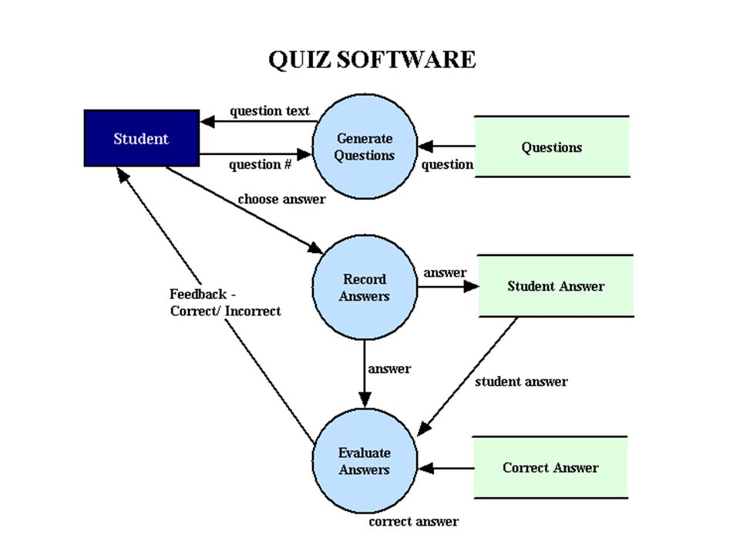
Data Flow Diagram :

Slide 11
System Requirements :
Software Requirements
HTML is used to design structure of the page.
CSS is used to create styles to the html page.
React.js is used for framework.
MY SQL is used for database of the page.
Java is used for backend of the project

Slide 12
Hardware Requirements
PROCESSOR – Intel CORE i5
RAM – 8GB
HARD DISK – 150GB

Slide 13
Conclusion :
The quiz buzz app provides a versatile platform for creating engaging and interactive quizzes. Its user-friendly interface allows users to easily generate quizzes tailored to their specific needs, whether for educational purposes, training sessions, or recreational activities. The app's customizable features, such as question types, difficulty levels, and multimedia integration, enhance the overall learning experience and cater to diverse audiences. The app's compatibility across multiple devices further increases accessibility, enabling users to take quizzes anytime, anywhere. Overall, the quiz buzz app offers a valuable tool for educators, trainers, and quiz enthusiasts alike, fostering knowledge retention, skills development, and enjoyment. With continuous updates and improvements, it has the potential to further enhance learning experiences and become a staple tool in various educational and professional settings.

Slide 14


